Slide 1
Singular Value Decomposition
Jaya Sil

Slide 2
Introduction
Linear algebra studies linear transformations, which are represented by matrices acting on vectors.
In linear algebra, the Singular Value Decomposition (SVD) of a matrix is a factorization of that matrix into three matrices.
To understand SVD we need to first understand the Eigenvalue Decomposition of a matrix.
In mathematics, eigenvalue, eigenvector, and eigenspace are related concepts in the field of linear algebra.

Slide 3
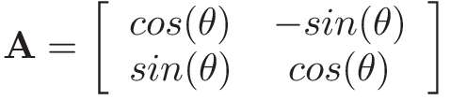
Linear Transformation
A matrix A is transformed so that it acts on a vector x by multiplication to produce a new vector Ax.
The rotation matrix in a 2-d space can be defined as:
This matrix rotates a vector
about the origin by the angle θ
An Eigenvector of a square matrix is a vector that points in a direction which is invariant under the Linear Transformation.
Eigen Vectors give the direction of spread of data, while eigen value is the intensity of spread in a particular direction or of that respective eigen vector.

Slide 4
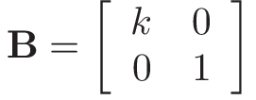
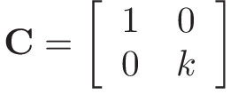
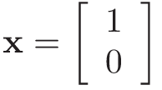
Transormation
Stretching matrix B in a 2-d space which is defined as:
This matrix stretches a vector along the x-axis by a constant factor k but does not affect it in the y-direction.
We can have a stretching matrix in y-direction:

Slide 5
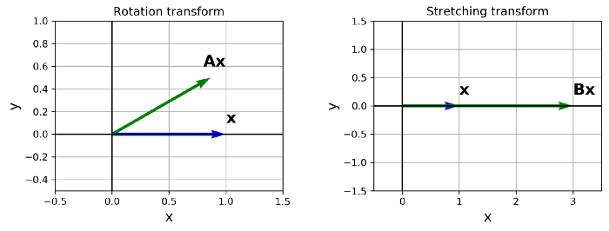
Transformation
y is the transformed vector of x as y = A x
The rotation matrix is calculated for θ = 30⁰ and in the stretching matrix k=3.

Slide 6
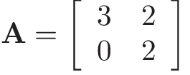
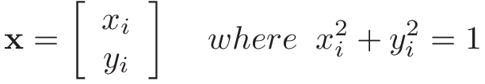
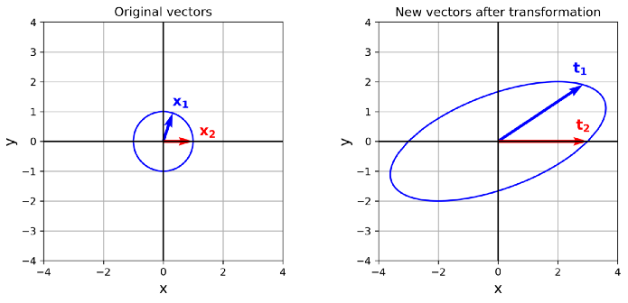
We have a circle that contains all the vectors that are one unit away from the origin.
Now we calculate t=Ax.
So t is the set of all the
vectors in x which have
been transformed by A.
The plots of x and t and the effect of transformation on two sample vectors x₁ and x₂ in x.
The transformation matrix somehow changes this circle and turns it into an ellipse.

Slide 7

Eigenvalues and Eigenvectors
Matrix A only stretches x₂ in the same direction and gives the vector t₂ which has a bigger magnitude.
The only way to change the magnitude of a vector without changing its direction is by multiplying it with a scalar.
So if we have a vector u, and λ is a scalar quantity then λu has the same direction and a different magnitude.
So for a vector like x₂ , the effect of multiplying by A is like multiplying it with a scalar quantity like λ, but not true for all the vectors in x.

Slide 8

Eigenvectors
For each matrix A, only some of the vectors have this property.
These special vectors are called the eigenvectors of A and their corresponding scalar quantity λ is called an eigenvalue of A for that eigenvector.
The eigenvector of an n×n matrix A is defined as a nonzero vector u such that:
u is the eigenvector corresponding to the eigenvalue λ.

Slide 9
Eigenvectors

Slide 10
Eigenvalues
(A – λI) u= 0 (3)
A − λI is called characteristic matrix.
By Cramer’s rule, System (3) has nontrivial solutions iff
det (A − λI ) = 0 (4)
The left-hand side of equation (4) is known as the characteristic polynomial and is given by
φ(λ) = det(A−λI) (5)
The polynomial (5) has degree n equal to the order of the square matrix A.
There are n roots of the equation (4) and hence n Eigenvalues of A.

Slide 11
Example:
Consider the transformation matrix
The characteristic polynomial= φ(λ) = |A − λI | = 3 − 4λ + λ².
Eigenvalues are λ = 1 and λ = 3.
Eigenvectors (Solution of (3)) are u₁ = −1 , u₂ = 1 .

Slide 12

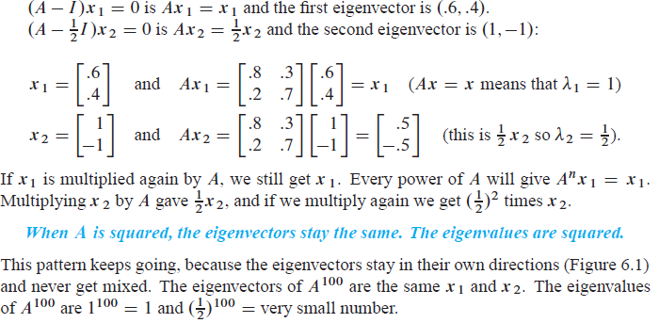
How to calculate Eigen vector?

Slide 13
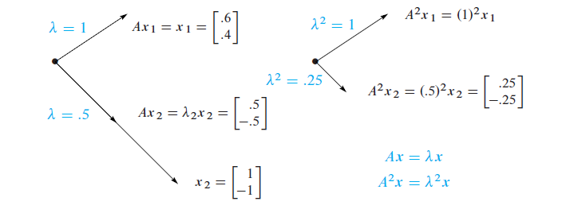

Slide 14

Normalized Vector
To normalize a vector u, we simply divide it by its length to have the normalized vector n:
The normalized vector n is still in the same direction of u, but its length is 1.
Eigenvectors are important because an eigenvector simplifies the matrix multiplication into a scalar multiplication.

Slide 15
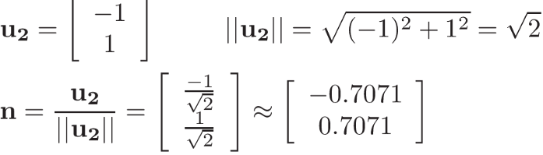
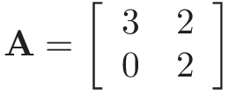
Properties
By normalizing an eigenvector corresponding to an eigenvalue, you still have an eigenvector for that eigenvalue.
This matrix transformed a set of vectors forming a circle into a new set forming an ellipse.

Slide 16
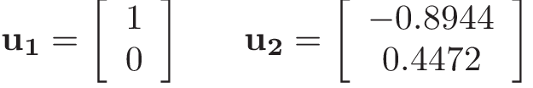
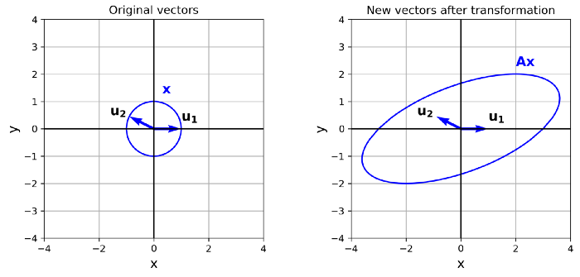
We have two eigen vectors for two eigen values λ₁ and λ₂

Slide 17
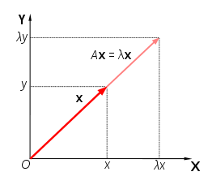
Property
Ax = λx; A²x = Aλx = λAx = λ² x
Eigen vectors are same for A and A² though eigenvalues are different; A^{n}x = λ^{n} x
Suppose you need to compute A¹⁰⁰. which was found by using the eigenvalues of A, not by multiplying 100 matrices.
Certain vectors x are in the same direction as Ax. Those are the “eigenvectors”.

Slide 18
Basis
A set of vectors {v1, v2, v3 …, vn} form a basis for a vector space V, if they are linearly independent and span V.
The span of subspace generated by vectors where Span (v1, v2) = {rv1 +sv2}: r, s ∈ R}
A vector space is a set of vectors that can be added together or multiplied by scalars.
Euclidean space R² is an example of a vector space.
When a set of vectors is linearly independent, it means that no vector in the set can be written as a linear combination of the other vectors.

Slide 19
Linearly independent
It is not possible to write when some of a1, a2, .., an are not zero.
In other words, none of the v_{i} vectors in this set can be expressed in terms of the other vectors.
A set of vectors spans a space if every other vector in the space can be written as a linear combination of the spanning set.
So every vector s in V can be written as:

Slide 20
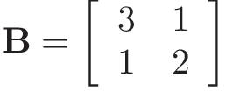
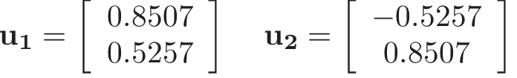
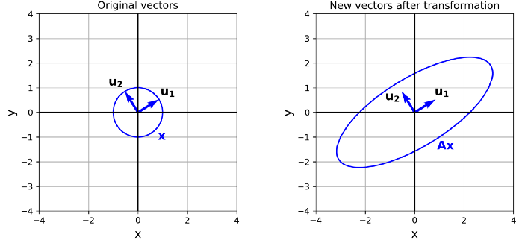
Two eigenvalues λ₁ = 3.618 and λ₂ = 1.382
Two eigenvectors:
An ellipse can be thought of as a circle stretched or shrunk along its principal axes.

Slide 21
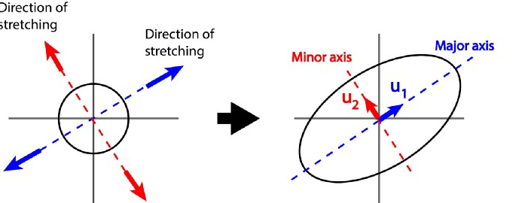
A symmetric matrix is a matrix that is equal to its transpose.
A symmetric matrix transforms a vector by stretching or shrinking it along its eigenvectors.
Matrix B transforms the initial circle by stretching it along u₁ and u₂, the eigenvectors of B, which is symmetric.

Slide 22
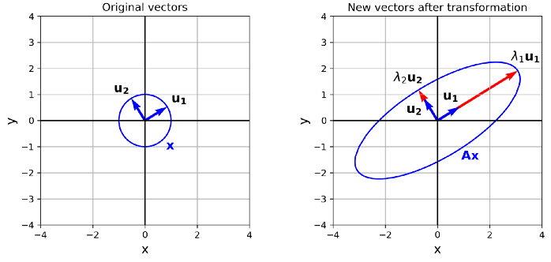
The amount of stretching or shrinking along each eigenvector is proportional to the corresponding eigenvalue.

Slide 23
Orthogonal Vectors
The eigenvectors of the symmetric matrix B are perpendicular to each other and form orthogonal vectors.
An important property of the symmetric matrices is that an n×n symmetric matrix has n linearly independent and orthogonal eigenvectors, and it has n real eigenvalues corresponding to those eigenvectors.
These eigenvalues are not necessarily different from each other and some of them can be equal.
Another important property of symmetric matrices is that they are orthogonally diagonalizable.

Slide 24
Eigen Decomposition
A symmetric matrix is orthogonally diagonalizable means that if we have an n×n symmetric matrix A, we can decompose it as A = PDP^{T}
where D is an n×n diagonal matrix comprised of the n eigenvalues of A.
P is also an n×n matrix, and the columns of P are the n linearly independent eigenvectors of A that correspond to those eigenvalues in D .

Slide 25
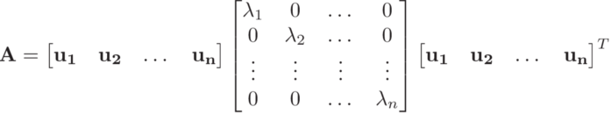
In other words, if u₁, u₂, u₃ …, u_{n} are the eigenvectors of A, and λ₁, λ₂, …, λ_{n} are their corresponding eigenvalues respectively, then A can be written as

Slide 26
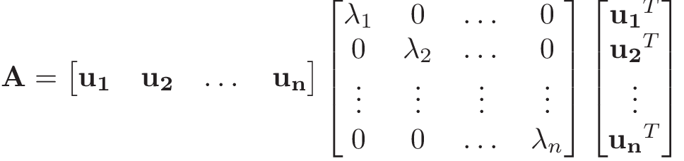
eigendecomposition
Each u_{i} is considered a column vector and its transpose is a row vector.
So the transpose of P has been written in terms of the transpose of the columns of P.
This factorization of A is called the eigen decomposition of A.

Slide 27
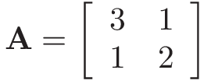

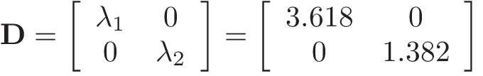

The columns of P are the eigenvectors of A that correspond to those eigenvalues in D respectively.

Slide 28

Eigen Decomposition

Slide 29
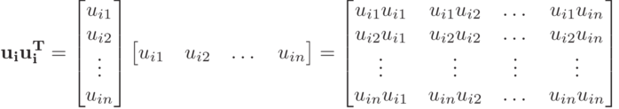
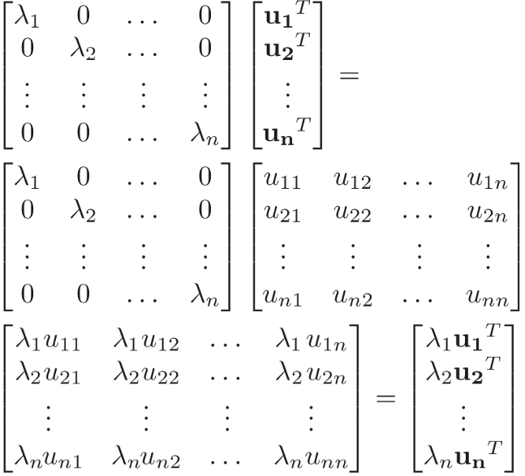
Each eigenvector u_{i} is an n×1 vector
Multiplication of u_{i} and its transpose becomes an n×n matrix.
DP^{T} =

Slide 30
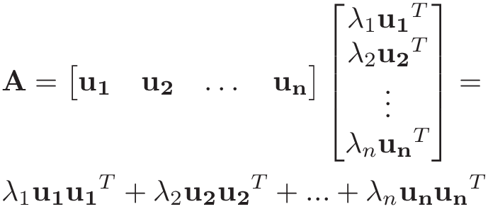
eigendecomposition
The eigendecomposition equation becomes:
So the n×n matrix A can be broken into n matrices with the same shape (n×n), and each of these matrices has a multiplier which is equal to the corresponding eigenvalue λ_{i}.

Slide 31

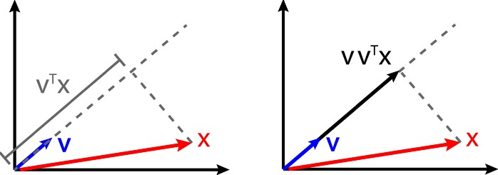
projection matrix
Each of the matrices are called projection matrix.
Imagine that we have a vector x and a unit vector v.
The inner product of v and x (v.x) gives the scalar projection of x onto v (which is the length of the vector projection of x into v), and if we multiply it by v again, it gives a vector which is called the orthogonal projection of x onto v.

Slide 32


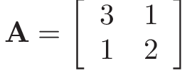
Orthogonal projection
When v is a unit vector, multiplying by x, will give the orthogonal projection of x onto v, called the projection matrix.
So multiplying by x, we get the orthogonal projection of x onto u_{i}.
Eigendecomposition equation
It is also a symmetric matrix.

Slide 33
Projection matrix
In fact, all the projection matrices in the eigendecomposition equation are symmetric.
That is because the element in row m and column n of each matrix and the element at row n and column m has the same value which makes it a symmetric matrix.
λ_{i} u_{i} u_{i}^{T} is equal to λ_{i} u_{im} u_{in}
The element at row n and column m has the same value which makes it a symmetric matrix.
This projection matrix has some interesting properties.

Slide 34
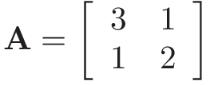

λ = [ 3.618 0] u = [[ 0.8507 -0.5257] [ 0.5257 0.8507]]
Two eigenvalues, one is zero and the other is equal to λ1 of the original matrix A.
The eigenvectors are exactly the same eigenvectors of A.
The i-th term in the eigendecomposition equation is multiplied by ui.

Slide 35


Now if you look at the definition of the eigenvectors, this equation means that one of the eigenvalues of the matrix
We know that ui is an eigenvector and it is normalized, so its length and its inner product with itself are both equal to 1.
One of the eigenvalues of the matrix
is λi and the corresponding eigenvector is ui.
But this matrix is an n×n symmetric matrix and should have n eigenvalues and eigenvectors.
Now we can multiply it by any of the remaining (n-1) eigenvalues of A to get: where i ≠ j

Slide 36

We know that the eigenvalues of A are orthogonal which means each pair of them are perpendicular.
The inner product of two perpendicular vectors is zero (since the scalar projection of one onto the other should be zero).
So the inner product of ui and uj is zero, and we get
which means that uj is also an eigenvector and its corresponding eigenvalue is zero. So we conclude that each matrix
in the eigendecomposition equation is a symmetric n×n matrix with n eigenvectors.

Slide 37
The eigenvectors are the same as the original matrix A which are u1, u2, … un.
The corresponding eigenvalue of ui is λi (which is the same as A), but all the other eigenvalues are zero.
Now, remember how a symmetric matrix transforms a vector.
It will stretch or shrink the vector along its eigenvectors, and the amount of stretching or shrinking is proportional to the corresponding eigenvalue.
So this matrix will stretch a vector along ui.
But since the other eigenvalues are zero, it will shrink it to zero in those directions.

Slide 38
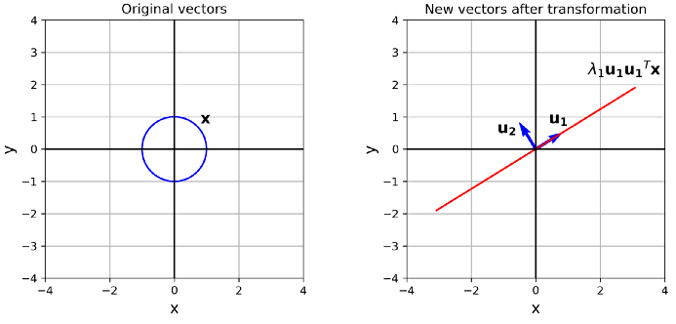
The initial circle is stretched along u1 and shrunk to zero along u2.
So the result of this transformation is a straight line, not an ellipse.
This is consistent with the fact that A1 is a projection matrix and should project everything onto u1, so the result should be a straight line along u1.

Slide 39
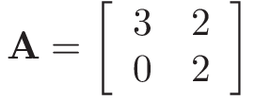

The eigenvectors are linearly independent, but they are not orthogonal and they do not show the correct direction of stretching for this matrix after transformation.

Slide 40
SVD
The eigendecomposition method is very useful, but only works for a symmetric matrix.
A symmetric matrix is always a square matrix, so if you have a matrix that is not square, or a square but non-symmetric matrix, then you cannot use the eigendecomposition method to approximate it with other matrices.
SVD can overcome this problem.
Find a way to calculate the stretching directions for a non-symmetric matrix.
Suppose that A is an m×n matrix and A^{T}A is a n×n symmetric matrix.

Slide 41




But vi is normalized, so
A^{T}A is a symmetric matrix, so it has n real eigenvalues and n linear independent and orthogonal eigenvectors which can form a basis for the n-element vectors that it can transform (in R^{n} space).
We call these eigenvectors v1, v2, … vn and we assume they are normalized.
For each of these eigenvectors using the definition of length and the rule for the product of transposed matrices to have:
Now we assume that the corresponding eigenvalue of vi is λi
But Vi is normalized so =
This result shows that all the eigenvalues are positive.

Slide 42

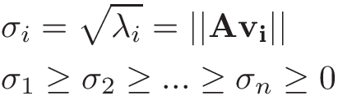
Assume that we label them in decreasing order, so:
Now we define the singular value of A as the square root of λi (the eigenvalue of A^{T} A), and we denote it with σi.
So the singular values of A are the length of vectors Av_{i}.

Slide 43
Backbone of the SVD method
Now we can summarize an important result which forms the backbone of the SVD method.
It can be shown that the maximum value of ||Ax|| subject to the constraints
is σk, and this maximum is attained at vk. For the constraints, we used the fact that when x is perpendicular to vi, their dot product is zero.
So if vi is the eigenvector of A^{T} A (ordered based on its corresponding singular value), and assuming that ||x||=1, then Avi is showing a direction of stretching for Ax, and the corresponding singular value σi gives the length of Avi.

Slide 44

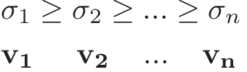


Singular Value Decomposition (SVD)
Let A be an m×n matrix and rank A = r. The number of non-zero singular values of A is r. Since they are positive and labeled in decreasing order, we can write them as
Where
We know that each singular value σi is the square root of the λi (eigenvalue of A^{T}A), and corresponds to an eigenvector vi with the same order.
The singular value decomposition of A as:

Slide 45
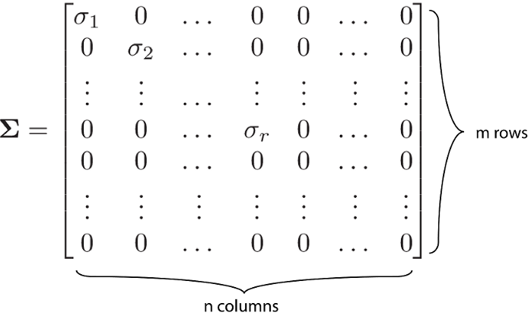
We call a set of orthogonal and normalized vectors an orthonormal set. So the set {vi} is an orthonormal set.
A matrix whose columns are an orthonormal set is called an orthogonal matrix, and V is an orthogonal matrix.
Σ is an m×n diagonal matrix of the form:
So we first make an r × r diagonal matrix
with diagonal entries of σ1, σ2, …, σr.
Then we pad it with zero to make
it an m × n matrix.

Slide 46
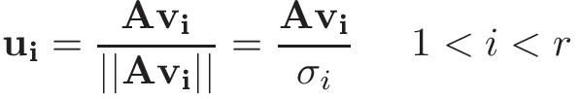
The set {Av1, Av2, …, Avr} is an orthogonal basis for Col A, and σi = ||Avi||.
So we can normalize the Avi vectors by dividing them by their length:
Now we have a set {u1, u2, …, ur} which is an orthonormal basis for Ax which is r-dimensional.
We know that A is an m × n matrix, and the rank of A can be m at most (when all the columns of A are linearly independent).
Since we need an m×m matrix for U, we add (m-r) vectors to the set of ui to make it a normalized basis for an m-dimensional space R^m

Slide 47

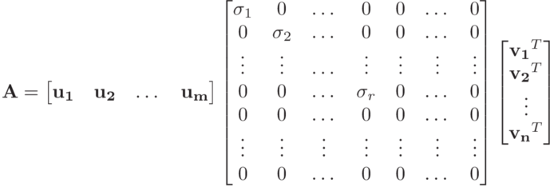
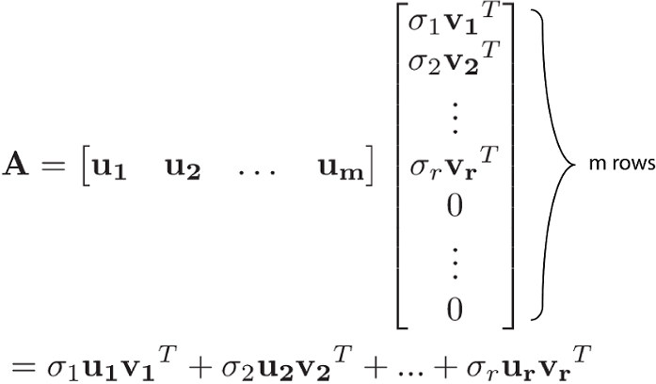
So now we have an orthonormal basis {u1, u2, … ,um}. These vectors will be the columns of U which is an orthogonal m×m matrix.
The SVD equation decomposes the matrix A into r matrices with the same shape (m×n).

Slide 48
How to construct the matrices Σ and V
We first sort the eigenvalues in descending order.
The columns of V are the corresponding eigenvectors in the same order.
Then we filter the non-zero eigenvalues and take the square root of them to get the non-zero singular values.
We know that Σ should be a 3×3 matrix.
So we place the two non-zero singular values in a 2×2 diagonal matrix and pad it with zero to have a 3 × 3 matrix.
Sigma= [[9.493 0 ] [ 0 3.5893]] V= [[ 0.9415 0.0969 0.3228] [ 0.3314 -0.0906 -0.9391] [-0.0617 0.9912 -0.1174]]

Slide 49
To construct V, we take the vi vectors corresponding to the r non-zero singular values of A and divide them by their corresponding singular values.
Since A is a 2×3 matrix, U should be a 2×2 matrix.
We have 2 non-zero singular values, so the rank of A is 2 and r=2.
As a result, we already have enough vi vectors to form U.
U= [[ 0.4121 0.9111] [ 0.9111 -0.4121]]

Slide 50
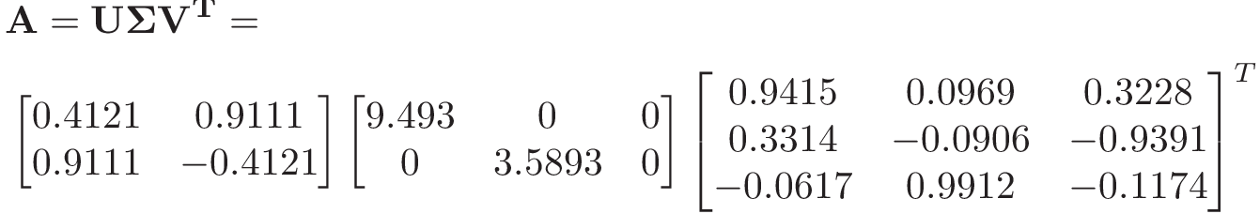
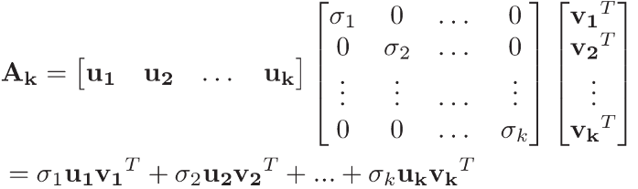
Similar to the eigendecomposition method, we can approximate our original symmetric matrix A by summing the terms which have the highest singular values. So we can use the first k terms in the SVD equation, using the k highest singular values which means we only include the first k vectors in U and V matrices in the decomposition equation:

Slide 51
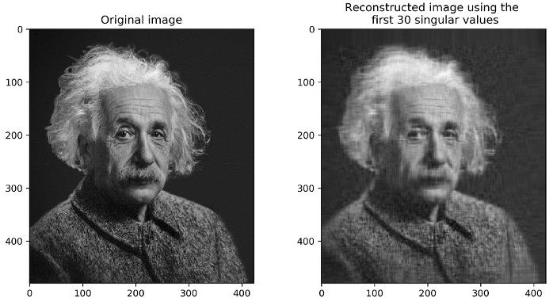
The original matrix is 480×423=203040 values.
After SVD each ui has 480 elements and each vi has 423 elements. To be able to reconstruct the image using the first 30 singular values we only need to keep the first 30 σi, ui, and vi which means storing 30×(1+480+423)=27120 values.
This is roughly 13% of the number of values required for the original image. So using SVD we can have a good approximation of the original image and save a lot of memory.

